Slide 2

1
6
Lesson 16
Solid Geometry II
Tetrahedron and Sphere

Slide 3
Part 1
Regard Tetrahedron as a pyramid

Slide 4

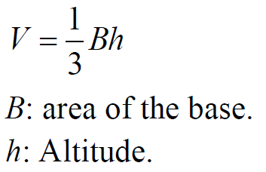
Lead in

Slide 5
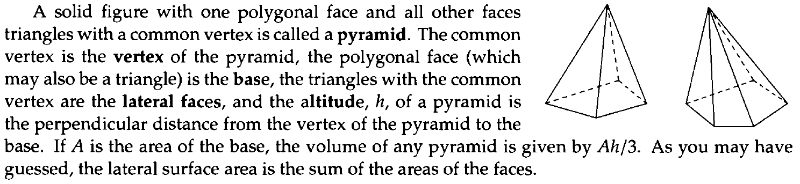
Lead in

Slide 6
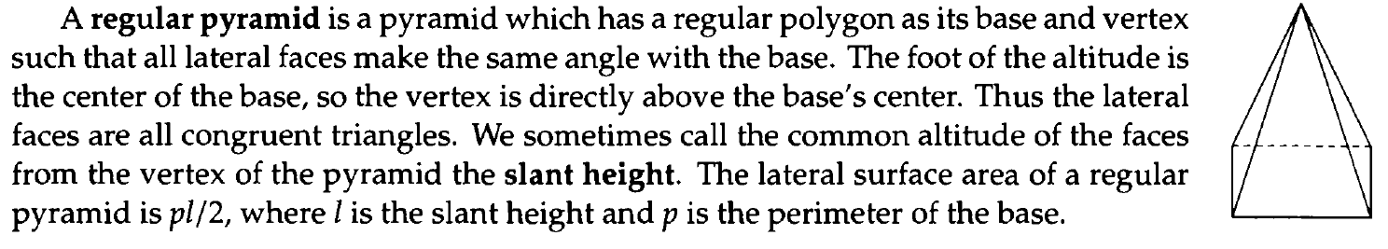
Lead in

Slide 7
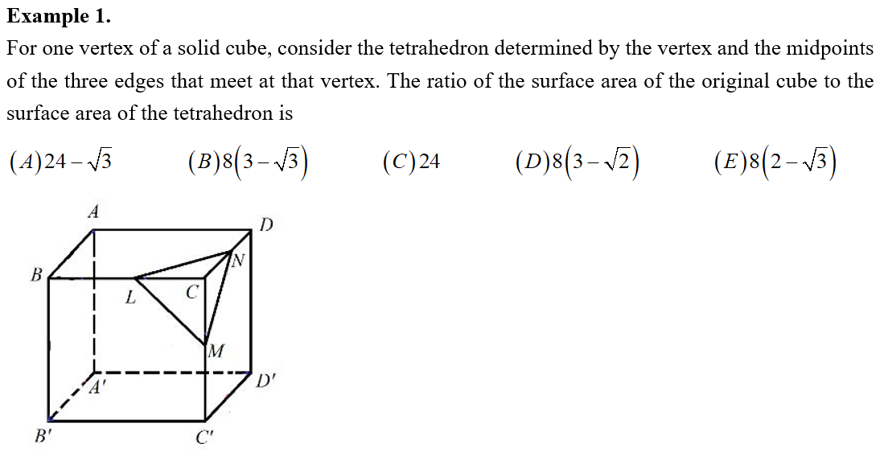
Example

Slide 8
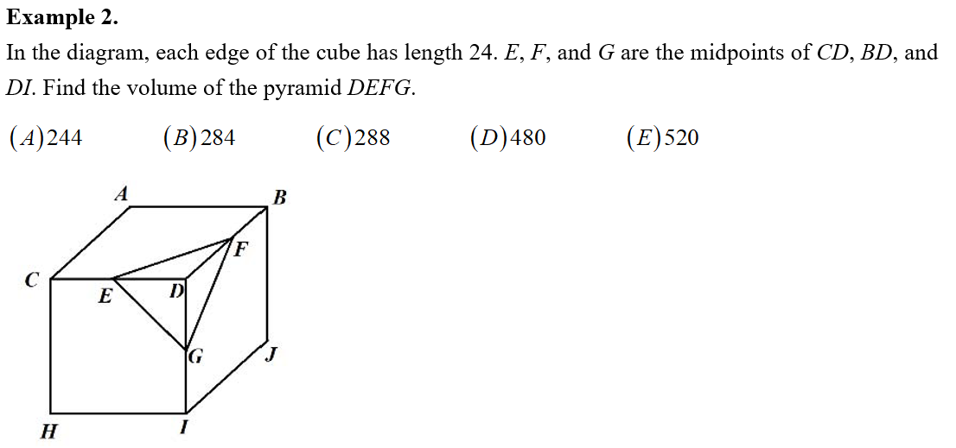
Example

Slide 9
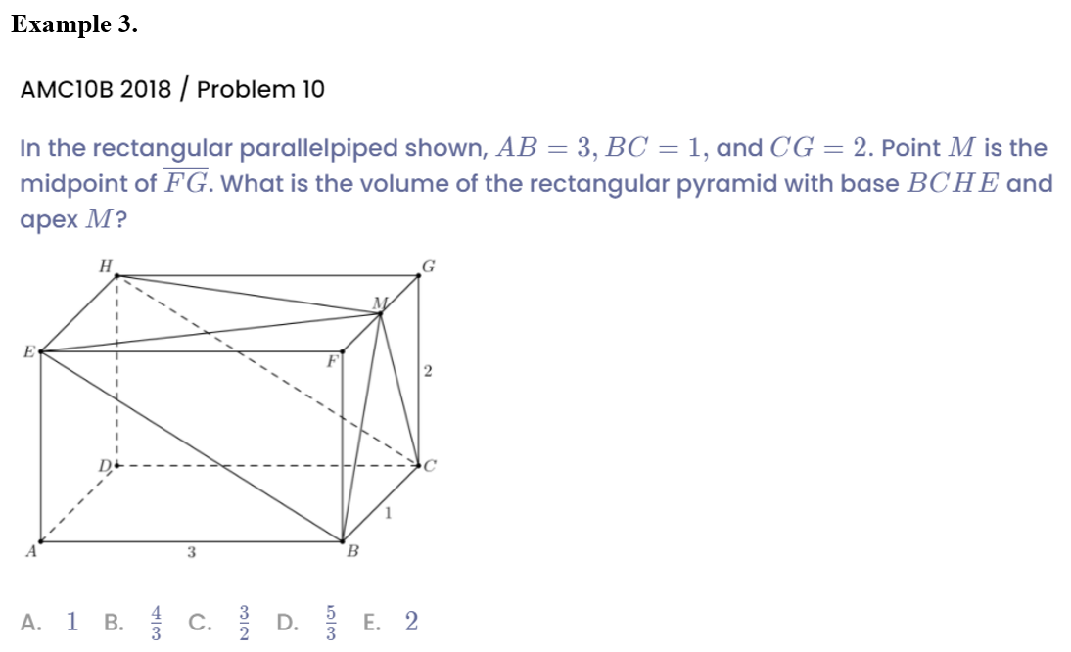
Example

Slide 10
Part 2
Distance from point to plane

Slide 11
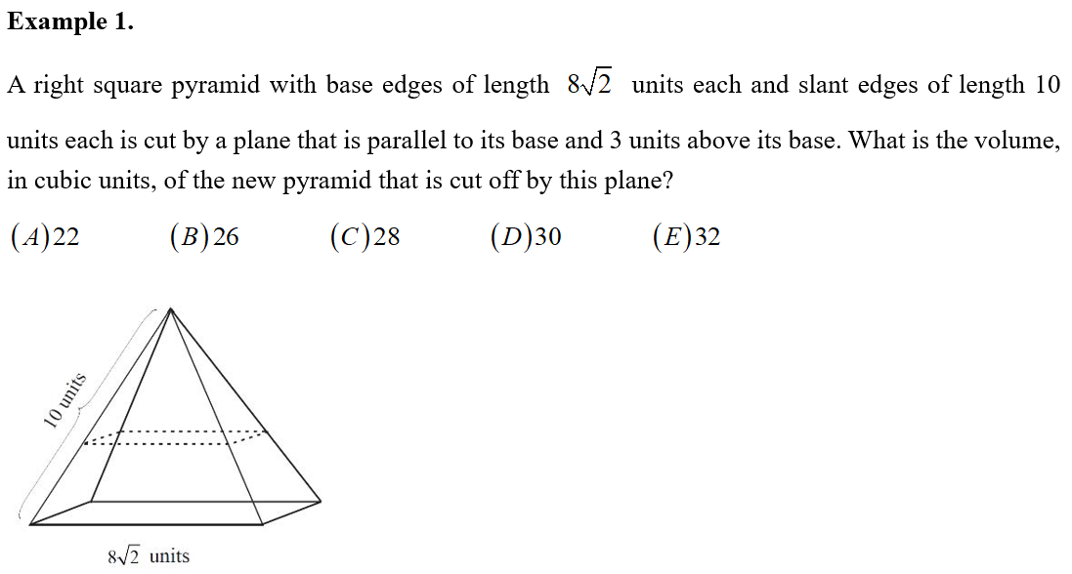
Example

Slide 12
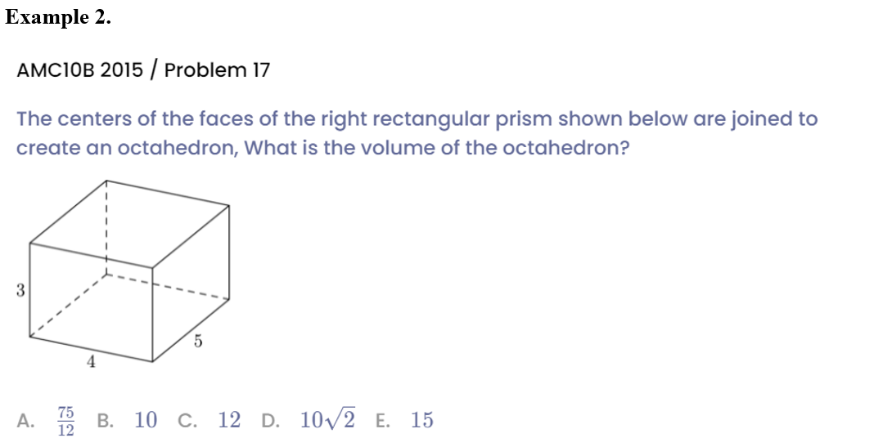
Example

Slide 13
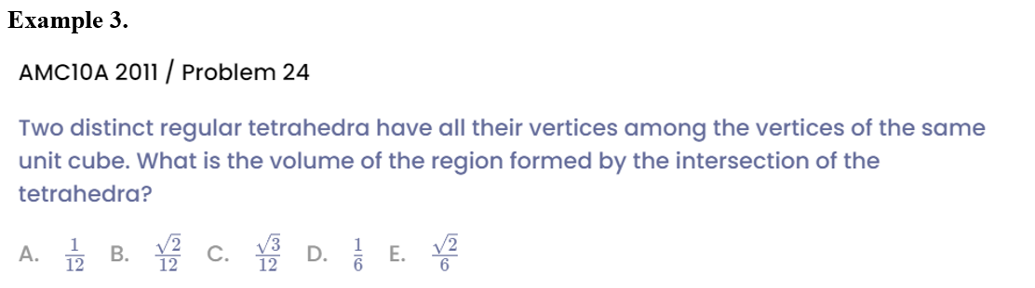
Example

Slide 14
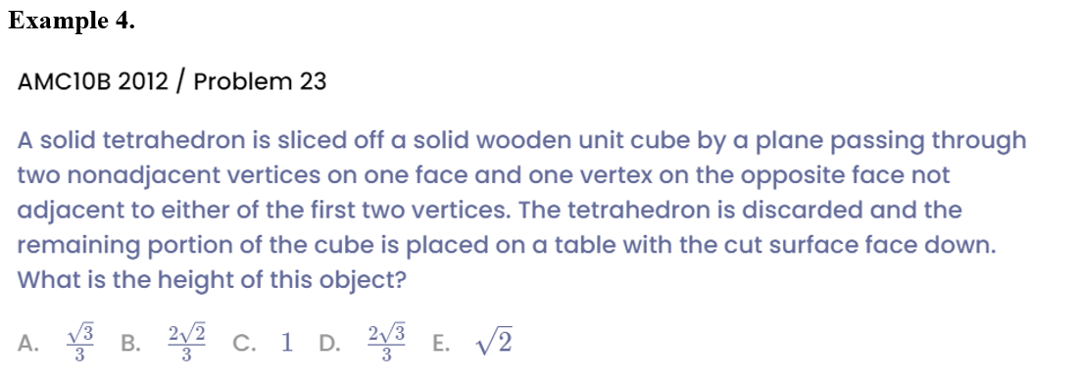
Example

Slide 15
Part 3
Sphere

Slide 16
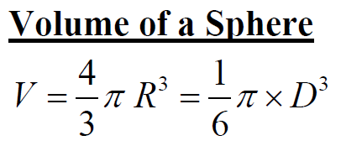
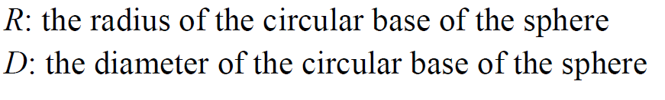
Lead in

Slide 17
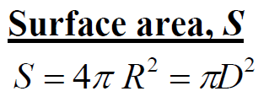
Lead in

Slide 18
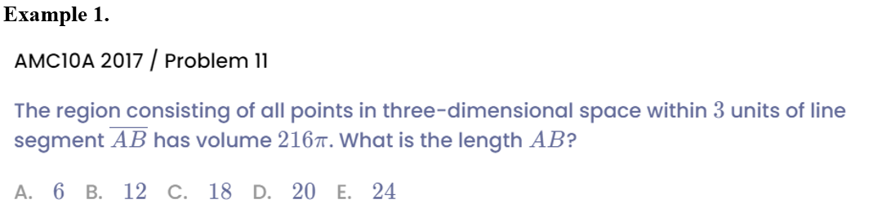
Example

Slide 19
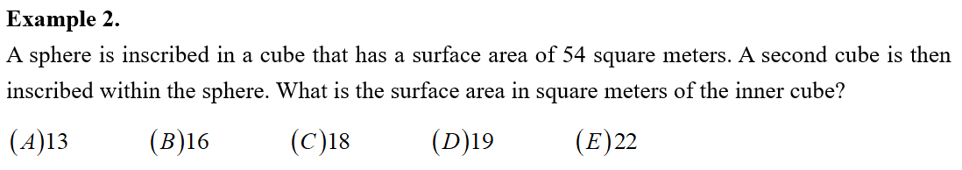
Example

Slide 20
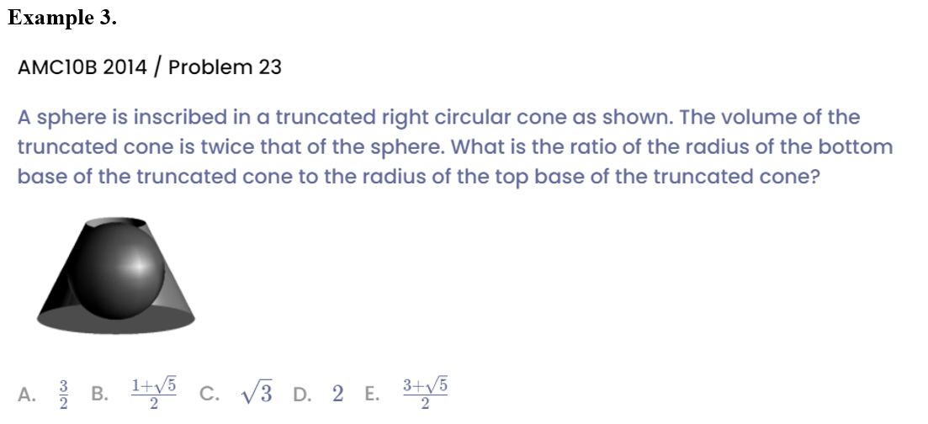
Example

Slide 21
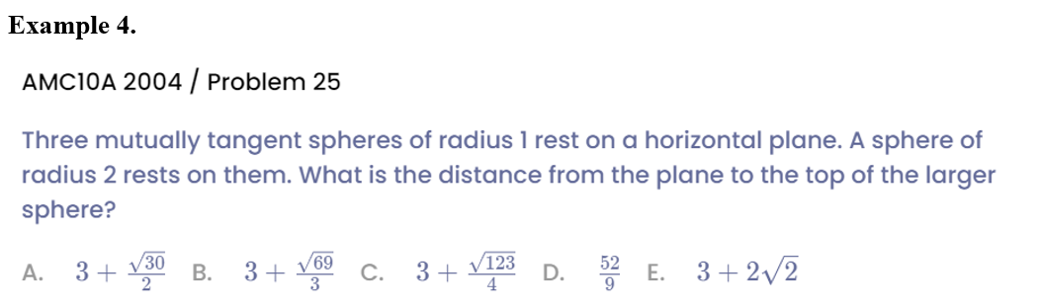
Example

Slide 22
See You Next Time!

